Slide 1


Attraction and Beauty
[Professor Name]
[Class Section Number]
Notes:
Class Recommendations: This module can be taught in one 90-minute class, or two-shortened class periods (45 to 60 minutes).
Overview: This module describes some research about attraction and beauty.
Warm up Questions: What qualities does a beautiful person have? How do you decide if someone is beautiful?
Explanation: Students may come up with answers that include non-physical qualities, which can lead to a discussion about how we determine who is attractive. Physical attractiveness matters a lot in first impressions as well as who we want to date.
Technical Note: These slides may contain simple click animation so that you can focus students’ attention on a particular question, a selection of text, or an image and not have them be distracted by reading ahead. You can either preview the sequence of animation by going through the slides in slideshow view, visiting the animations tab, or reviewing the slide notes. In the notes you will see a cue - (Click) – that corresponds to each animation.
You will also find hyperlinks to outside videos at various places in the slides. These hyperlinks are embedded in text and indicated by color and in the notes section.

Slide 2
Today’s Learning Objectives
Learn the advantages of attractiveness in social situations.
Know what features are associated with facial, body, and vocal attractiveness.
Understand the universality and cultural variation in attractiveness.
Learn about the mechanisms proposed to explain positive responses to attractiveness.
Notes:
This slide outlines the learning objectives of the module.

Slide 3
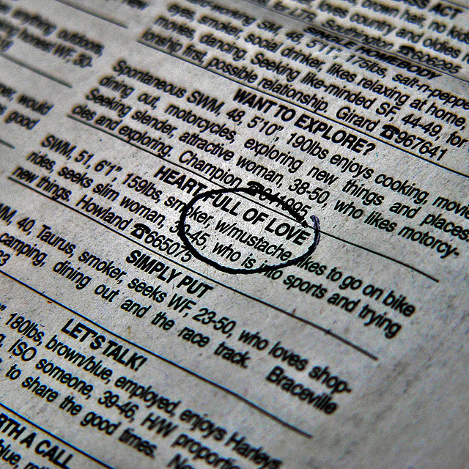
Warm Up Activity
Pull out a sheet of paper; don’t put your name on it
You are looking for a romantic partner
Write a personal ad with description of the person
Indicate your gender and their gender
Is attractiveness more important for short-term relationships than long-term? Why or why not?
Notes:
This slide outlines a warm-up activity. This activity has students write personal ads, and it is also described in the IM under ‘Activities/Demonstrations.’
If you are presenting the information in this module on 1 day, you may not have time for this activity, especially if you are teaching a 50-minute class.
(Click) Pull out a sheet of paper. You will turn it in, but do not put your name on it.
This helps keep their responses anonymous.
(Click) Imagine that you are looking for a romantic partner.
Some students may already be in relationships or may otherwise not be looking for a partner, so ask them to creatively imagine it.
(Click) Write a personal ad that includes a description of the person you would like to meet.
This ensures that they have a physical description in their personal ad, and it gets them to think about physical characteristics of their preferred partner.
(Click) Indicate your gender and the gender of the person you would like to meet.
If you ask about gender, then you may be able to pick up on any gender differences in students’ responses. Some previous research has found such a difference and other previous research has not.
The creators of this activity (Isbell & Tyler, 2005) have noted that this activity can illustrate how important attractiveness is in mate selection, even though students may self-report that attractiveness is not that important. Another topic that will likely be brought up is the gender difference in mate preference for short-term sexual relationships.
(Click) Discussion question: Is attractiveness of a potential partner more important for short-term relationships than long-term relationships? Why or why not?
Explanation: Some previous research (Kendrick et al., 1990) has found a gender difference in mate preference for casual sex partners but not for long-term relationships. This question is intended to get students to think about when and how attractiveness might matter in relationships.
References:
Isbell, L. M., & Tyler, J. M. (2005). Using students' personal ads to teach about interpersonal attraction and intimate relationships. Teaching of Psychology, 32, 170-172. doi:10.1207/s15328023top3203_9
Kenrick, D. T., Sadalla, E. K., Groth, G., & Trost, M. R. (1990). Evolution, traits, and the stages of human courtship: Qualifying the parental investment model. Journal of Personality, 58(1), 97-116. doi:10.1111/j.1467-6494.1990.tb00909.x

Slide 4
Overview
Introduction
The Advantages of Attractiveness
What Makes a Person Attractive?
Why Are Certain People Attractive?
Conclusion
Notes:
This slide provides students with an overview of the material that will be covered during the lecture.

Slide 5

Introduction
Research on attraction includes sexual and nonsexual attraction
How important is it for your romantic partner to be attractive?
How important is it for you to be attractive?
Notes:
This slide introduces and orients students to the topic of attractiveness.
(Click): Research on attraction includes sexual and nonsexual attraction
Research on attraction includes sexual and nonsexual attraction: When you say “attraction,” students will likely think about sexual attraction and romantic relationships. While the study of attraction includes what factors we find attractive in potential romantic partners, it also includes what factors we find attractive in potential friends. So, “nonsexual attraction” would include who we like in a non-romantic way, such as when we decide whether an infant is an attractive infant or not.
Discussion Questions:
(Click): How important is it for your romantic partner to be attractive?
(Click): How important is it for you to be attractive?
If you had students do the optional warm up activity (see Slide 3), then this is a good time to refer back to that discussion.

Slide 6
Overview
Introduction
The Advantages of Attractiveness
  Attractiveness Halo Effect
  6 Advantages of High Attractiveness
What Makes a Person Attractive?
Why Are Certain People Attractive?
Conclusion
Notes:
This slide orients the students to what will be discussed next.

Slide 7

The Advantages of Attractiveness
Attractiveness Halo Effect
Yet attractive people are not . . .
  happier
  healthier
  more intelligent
Notes:
This slide begins the discussion of the advantages of being attractive and introduces the concept of the attractiveness halo effect.
(Click): Attractiveness Halo Effect
This effect is the finding that attractive people are more likely to be seen positively on many different traits. For example, attractive people are seen as being more intelligent, healthy, trustworthy, and sociable.
A note about the photo: You could bring up the research cited in the module which found that attractive babies are seen more positively by their parents and by strangers.
(Click) Yet attractive people are not
(Click) Happier, healthier, more intelligent

Slide 8

The Advantages of Attractiveness
Attractiveness Halo Effect
Why do you think the attractiveness halo exists if it is not true?
Is it a self-fulfilling prophesy?
Notes:
This slide continues the discussion of the attractiveness halo effect.
(Click) Why do you think the attractiveness halo exists even though it is not true?
Click) Is it a self-fulfilling prophesy?
When discussing the attractiveness halo effect, it may be advantageous to discuss self-fulfilling prophesy, which is not discussed in the module. The self-fulfilling prophesy states that people can create an outcome simply when they believe that outcome is already true. For example, if someone believes that a very attractive person is more sociable, then they will act toward that person in a friendlier manner, which causes the attractive person to reciprocate the friendliness.

Slide 9

The Advantages of Attractiveness
6 Advantages of High Attractiveness
  First Impressions
  Mating Prospects
  Parent and Peer Favoritism
  Education and Employment
  Electoral Success
  Judicial Outcomes
Notes:
This slide lists the advantages of being very attractive
(Click) First impressions
Highly attractive people tend to make better first impressions than their less-attractive counterparts.
(Click) Mating prospects
Attractiveness is associated with “greater reproductive success.” If you did the personal ad activity (see Slide 3), then you could refer back to it here.
(Click) Parent and peer favoritism
From early childhood, attractive people are more popular. Parents see their attractive babies more positively.
(Click) Education and employment
Attractive people are more likely to get hired, and they are more likely to earn higher salaries. You could also discuss college professors, and the research indicating that attractive professors are perceived more positively by students (see Gurung and Vespia (2007) information in the IM under ‘Evidence-Based Teaching’).
(Click) Electoral success
Politicians with more attractive voices are more likely to get elected. More attractive congressional candidates are more likely to be elected.
(Click) Judicial outcomes
If convicted, attractive people receive lighter sentences.
Reference:
Gurung, R. A., & Vespia, K. (2007). Looking good, teaching well? Linking liking, looks, and learning. Teaching of Psychology, 34(1), 5-10.

Slide 10

The Advantages of Attractiveness
The Economic Benefits of Being Beautiful
What do you think about the increasing popularity of plastic surgery & the amount of money spent on beauty products?
Notes:
This slide provides a link to a 1 min, 49 sec video with statistics about the advantages of being beautiful.
The video starts with information about how babies are treated differently, and it quickly cites 14 facts about the advantages of being attractive, including the halo effect. Seven of the 14 facts are focused on the occupational and economic advantages of attractiveness, and it ends with a fact about how much money is spent on beauty products. This is a fun, fast video, with lots of text and peppy music. It may be too fast for some students, especially students who do not read quickly. So, as with any video, it will be important to emphasize the points you wanted the students to get from the video after you show it.
The Economic Benefits of Being Beautiful: https://youtu.be/b_gx2Uc95os
(Click) Given the advantages of being very attractive, what do you think about the increasing popularity of plastic surgery and the amount of money spent on beauty products?
This discussion question can prompt students to think about the importance of attractiveness, as well as the lengths we go to in order to be more attractive. This link (http://tmagazine.blogs.nytimes.com//2015/07/14/cosmetic-surgery-statistics/) has an infographic with statistics on the increasing popularity of cosmetic surgery, which can give you some data to use in this discussion.

Slide 11

CAT: One-Minute Paper
What was the most important thing you learned during this class?
What important question remains unanswered?
Notes:
Classroom Assessment Technique (CAT): One-Minute Paper
If you are presenting the information on one class day, you might end the material about here. End your class time with a one-minute paper.
The Minute Paper tests whether students are gaining knowledge, or not. The instructor ends class by asking students to write a brief response to the following questions: “What was the most important thing you learned during this class?” and “What important question remains unanswered?”
Have students briefly answer these questions in writing and turn them in. After class, assess students’ responses. At the beginning of the next class, go over any misunderstandings or relevant questions.
If you do not conclude with this Classroom Assessment Technique (CAT), it would helpful to use another CAT. It could be in the form of a:
Muddy Point
One-Minute Paper
Background Knowledge
What’s the Principle?
Defining features Matrix:
For more information on CATs click here: http://cft.vanderbilt.edu/guides-sub-pages/cats/

Slide 12
Overview
Introduction
The Advantages of Attractiveness
What Makes a Person Attractive?
Why Are Certain People Attractive?
Conclusion
Notes:
This slide orients the students to the outline of the material.
This is a good time to go over the information from last class’s one-minute paper. What questions can you clear up at this point? What information can you reinforce?

Slide 13
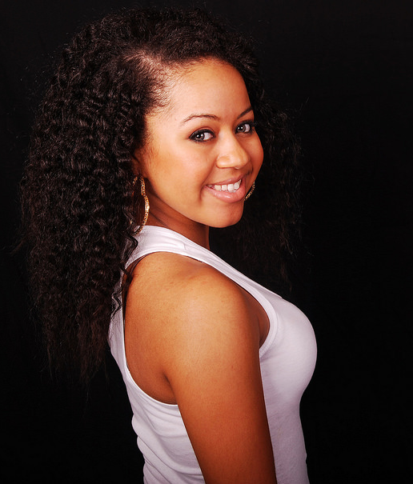
What Makes a
Person Attractive?
Hallmarks of High Attractiveness
Youthfulness
Unblemished skin
Symmetry
Averageness
Notes:
This slide highlights 4 of the 8 hallmarks of high attractiveness discussed in the module.
(Click): Hallmarks of High Attractiveness
People who have certain qualities tend to be considered attractive. No single characteristic will determine high attractiveness, as someone with excellent skin would not be considered attractive without some other characteristics on the list. However, missing one characteristic could make someone low in attractiveness. Remember that students are likely thinking about their own level of attractiveness while covering this material, and it may be helpful to emphasis the positive expressions and positive behaviors (on the next slide).
(Click): Youthfulness
We tend to find youthfulness attractive. This effect is limited, though. We find babyish facial features attractive in babies but it detracts from how we rate male leaders.
(Click): Unblemished skin
Unblemished skin is considered more attractive than blemished skin.
(Click): Symmetry
We tend to consider symmetry more attractive than asymmetry. For example, we rate symmetrical faces as more attractive than asymmetrical faces.
The slide contains a link to this video:
The Beauty of Symmetry: This 2 minute, 50 second video describes facial symmetry, and explains why our faces aren’t always symmetrical. The video shows a demonstration where a researcher photographs a man and a woman and then manipulates the photos. The researcher then showed people two photographs of the man (one more symmetrical and one more asymmetrical), said they were twins, and asked which twin was more attractive. The researcher did the same with the photos of the woman, and people were more likely to choose the symmetrical face as more attractive.
http://www.discovery.com/tv-shows/other-shows/videos/science-of-sex-appeal-the-beauty-of-symmetry/
(Click): Averageness
We like averageness as opposed to uniqueness. Faces closer to the population average are considered most attractive.

Slide 14
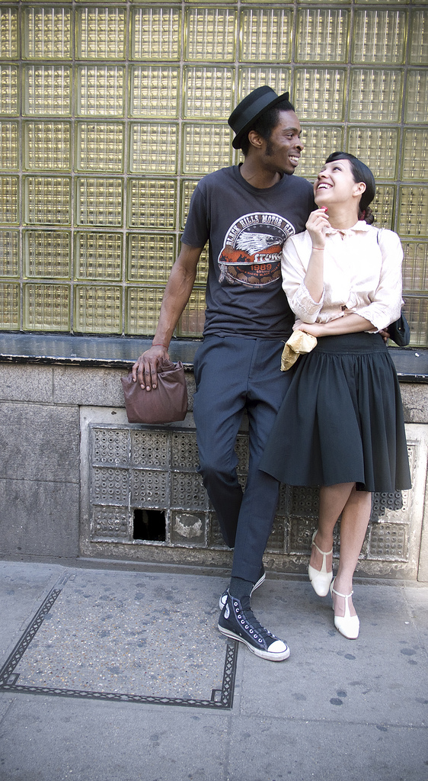
What Makes a
Person Attractive?
Hallmarks of High Attractiveness
Femininity in women
Masculinity in men
Positive expressions
Positive behaviors
Notes:
This slide highlights 4 of the 8 hallmarks of high attractiveness discussed in the module.
(Click): Femininity in women
We tend to prefer women with more feminized faces. Feminized faces tend to have smaller jaws, bigger eyes, and smaller eyebrows.
There is a link to this video:
Is Your Face Attractive?
This is a 2 minute, 55 second video. The researcher in the video discusses and shows examples of face morphs, and then manipulates pictures of faces, making them more or less masculine or feminine. We tend to prefer women with more feminized faces and men with more masculine faces, and the video briefly connects these changes to good health.
http://www.discovery.com/tv-shows/other-shows/videos/science-of-sex-appeal-is-your-face-attractive/
(Click): Masculinity in men
We tend to prefer men with more masculinized faces. Masculinized faces tend to have larger, squarer jaws with a longer face.
(Click): Positive expressions
Do you find the person who is smiling or the person who is frowning more attractive? Smiling and facial expressivity is positively related to ratings of attractiveness.
(Click): Positive behaviors
Your actions and your personality can increase your attractiveness rating. We find a person more physically attractive when we have a positive impression of that person’s behaviors or personality.

Slide 15
Overview
Introduction
The Advantages of Attractiveness
What Makes a Person Attractive?
Why Are Certain People Attractive?
  Cultural Learning
  Preferences for Prototypes
  Signal of Mate Quality
  Overgeneralized Reactions
Conclusion
Notes:
The purpose of this slide is to provide students with an overview of the material that will be covered during the lecture. It also highlights the 4 topics covered under ‘Why Are Certain People Attractive?’

Slide 16
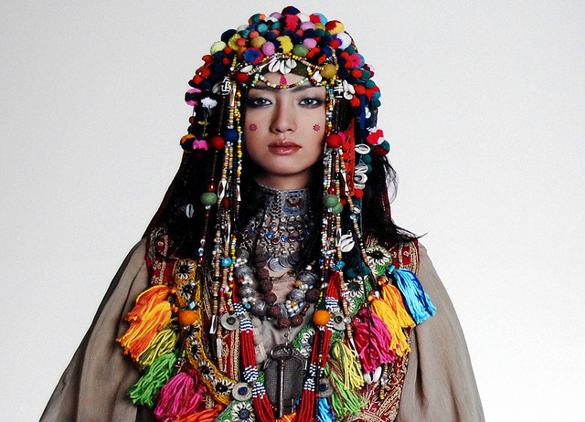
Why Are Certain
People Attractive?
Cultural Learning
How does culture affect who and what you think is attractive?
Notes:
This slide discusses how culture affects who and what we find attractive.
(Click) Cultural Learning
Although there are many cultural universals in what we find attractive, there are some cultural differences in our ratings of attractiveness. The module contains a picture of a long-necked woman in Myanmar, and it cites research such as the finding that Western European people view larger bodies more harshly than people from other cultures. Buss (1989) found that chastity was highly valued in some cultures (China, India, Indonesia, Iran, Taiwan, and the Palestinian territories of Israel) but was unimportant or negatively valued in other cultures (Finland, France, Norway, Sweden, the Netherlands, and West Germany).
(Click): How does culture affect who and what you think is attractive?
This question encourages students to think about how cultural influences, including the media, affect our perceptions of what is attractive. You can connect this discussion to the information in the module in the section, Cultural Learning. For changing cultural standards of beauty for women, see this video (https://youtu.be/Xrp0zJZu0a4) or this webpage (http://www.rehabs.com/explore/womens-body-image-and-bmi/).
Buss, D. M. (1989). Sex differences in human mate preferences: Evolutionary hypotheses tested in 37 cultures. Behavioral and Brain Sciences, 12, 1-14.

Slide 17
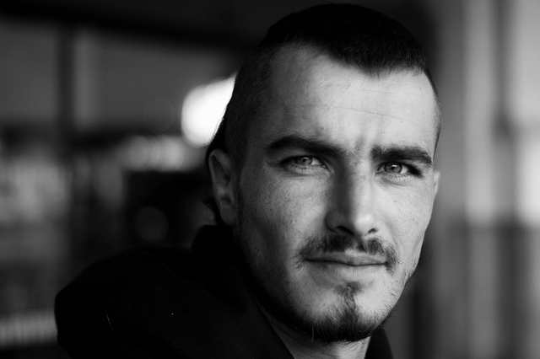
Why Are Certain
People Attractive?
Preferences for Prototypes
Prototype
Mere-exposure Effect
Face Morphs
Notes:
This slide highlights a cognitive explanation about why we find certain people attractive.
(Click) Preferences for Prototypes
(Click) Prototype
A prototype is an “average member of the category.” If I say “man” and an image pops into your mind, that image is likely your prototype of the category, man. People who are closer to the prototype or average tend to be considered more attractive. Hence, we have a preference for prototypes.
(Click) Mere-exposure Effect
This may be because we tend to prefer people and things we have seen before, which is the mere-exposure effect. This finding also extends to people and things that are similar to ones we have seen before. Have you ever noticed how a picture of yourself may look strange? You are used to looking at a mirror image of yourself every day, so if you aren’t used to looking at photos of yourself you may think you look weird in the photo.
(Click) Face Morphs
We also consider face morphs, averages of many different faces, more attractive than individual faces. The next slide contains an activity about face morphs.
If you didn’t show this video when discussing masculinity/femininity, it might be a good time to show it now:
Video: Is Your Face Attractive?
2 minute, 55 second video about face morphs and masculinity/femininity preferences in facial features: http://www.discovery.com/tv-shows/other-shows/videos/science-of-sex-appeal-is-your-face-attractive/

Slide 18
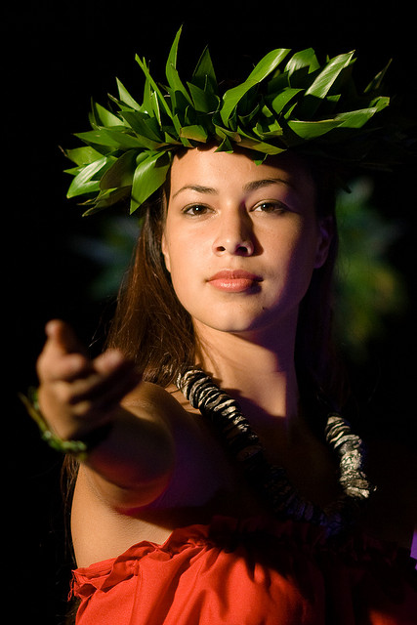
Face Morph Activity
Make an Average Face
Celebrity Averager
What did you learn from this activity?
What is the relationship between face morphs and attractiveness?
Notes:
This activity demonstrates face morphs, averages of many faces, and it will show that face morphs are more attractive than individual faces. It should also show that the more faces that are averaged, the more attractive the face morph is. The instructions below are for an in-class activity, but it could easily be adapted for an out-of-class activity.
Time: 10-15 minutes
Materials: Computer with internet connection; ability to project computer screen
(Click) Make an Average Face
This link takes you to the Make an Average Face website: http://www.faceresearch.org/demos/average
Pick two women’s pictures (or, if you have lots of time, have the students pick the women) from the pictures in the middle of the screen. Make sure the students can see which faces you are picking (the pictures will show up larger on the left when you place your cursor on them).
Select ‘View Average’ to see the face morph of those two women. It’s very likely that the face morph is more attractive than the two individual women.
Pick a third woman and click ‘View Average.’ Your previous selections will remain, so you do not have to select them again.
Pick a fourth woman and click ‘View Average.’ All of your face morphs are shown toward the bottom of the screen. It should be clear by now that the face morphs are 1) more attractive than the individual faces, and 2) often get more attractive, the more faces you pick.
Continue selecting women’s faces (depending on the time you have available). After the first few pictures, the face morphs doesn’t change as much, and you can pick many more pictures at one time to illustrate that face morphs with more faces are more attractive than a few faces.
Select “Clear Selections.” Repeat the process above with men’s faces.
(Click) Celebrity Averager
For fun, you can also go to Celebrity Averager: http://www.faceresearch.org/demos/famous
Note: This is not a good website for the original activity, as students will likely be distracted by the famous people, some of whom are photographed in character. Students’ like/dislike for certain actors and characters will likely make it harder for them to be objective about whether the individual picture or face morph is more attractive, which could be a matter for discussion, as liking and attraction are related.
(Click) What did you learn from this activity?
Students can get distracted when doing an activity (especially if you have just talked about and seen celebrity faces), so it’s nice to bring them back to the point of the exercise. What did they learn? Do they know what a face morph is? Can they describe it?
(Click) What is the relationship between face morphs and attractiveness?
The more faces that are morphed together, the more attractive that face is thought to be.

Slide 19
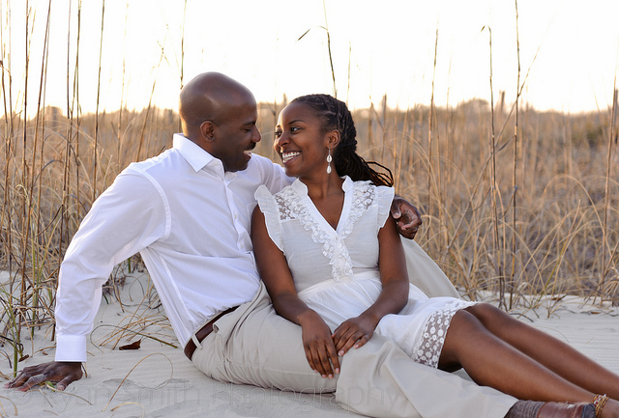
Why Are Certain
People Attractive?
Signal of Mate Quality
Good Genes Hypothesis
Notes:
This slide highlights one theory about why we find certain people attractive.
(Click) Signal of Mate Quality
This is an evolutionary explanation. Essentially, we use attractiveness as a cue that the person will be a mate with quality genes.
(Click) Good genes hypothesis
The good genes hypothesis states that we find qualities such as symmetry, averageness, prototypicality, and youthfulness attractive because they indicate better health, fertility, and genetic traits. There is some evidence that being very low on these attractiveness traits can predict low levels of health and intelligence. In general, though, these attractiveness qualities are poor predictors of traits associated with good health.

Slide 20
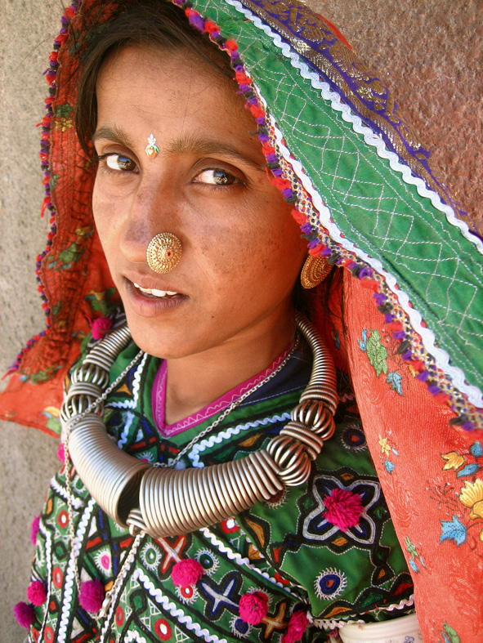
Why Are Certain
People Attractive?
Overgeneralized Reactions to Disease or Bad Genes
Anomalous face overgeneralization hypothesis
Notes:
This slide highlights one theory about why we find certain people attractive.
(Click) Overgeneralized Reactions to Disease or Bad Genes
This is another evolutionary explanation, based on the idea that we want to avoid ‘bad genes.’
(Click) Anomalous face overgeneralization hypothesis
This idea states that we overgeneralize to people whose faces resemble the unfit (i.e., the very unattractive), making all but the very attractive (like the woman in the photo) unfit or unattractive in our view.

Slide 21
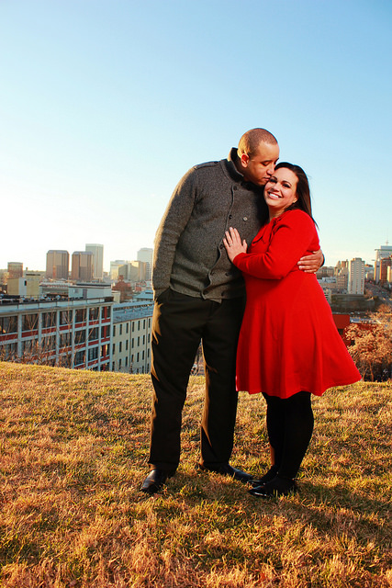
Why Are Certain
People Attractive?
Think → Pair → Share
Cultural Learning
Preferences for Prototypes
Signal of Mate Quality
Overgeneralized Reactions to Disease or Bad Genes
Which one do you think is the most compelling theory? Why?
Notes:
This slide reviews the 4 reasons the module highlights.
(Click) Which one do you think is the most compelling theory? Why?
Think/Pair/Share Activity
In a think/pair/share activity, students 1) think about answers to the question by themselves for a few minutes, 2) pair with another student and discuss their answers for a few minutes, and then 3) share their answers with the class. This activity can take 10-15 minutes, depending on the length of the discussion.

Slide 22
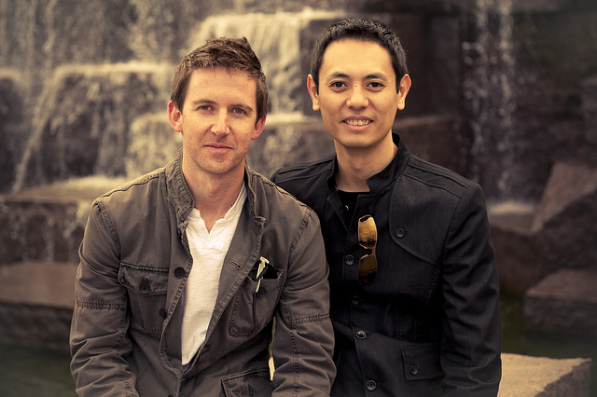
Conclusion
Notes:
Discussion/Conclusion Questions:
Attractiveness matters, but so do other qualities. The following information highlights how other factors, such as acquaintanceship length, can also be important.
You might consider ending this module with this information, as well as asking students what this finding implies:
Recent research findings show that romantic couples’ level of attractiveness is correlated if they started dating soon after meeting (predicted by the matching hypothesis). However, if they knew each other or were friends for a while before dating, they were less likely to match on physical attractiveness.
New York Times article link: http://nyti.ms/1HtIkFt
This is a summary of this research:
Hunt, L. L., Eastwick, P. W., & Finkel, E. J. (2015). Leveling the playing field: Longer acquaintance predicts reduced assortative mating on attractiveness. Psychological Science, 26(7), 1046-1053. doi:10.1177/0956797615579273

Slide 23
CAT: The Muddiest Point
What was the muddiest point in today’s class?
Write down what concept you are still struggling to understand.
Notes:
This slide contains the Muddiest Point Classroom Assessment Technique (CAT).
Ask students to write down the “muddiest point” – that is any concept they are still struggling to understand of any questions they still may have about the material. With remaining class time, ask students to share their muddiest point and provide additional review on these points.
If you do not conclude with this Classroom Assessment Technique (CAT), it would helpful to use another CAT. It could be in the form of a:
Muddy point
One-minute paper
Background knowledge
What’s the Principle?
Defining features Matrix:
For more information on CATs click here: http://cft.vanderbilt.edu/guides-sub-pages/cats/

Slide 24
Photo Attribution
Slide 1 | Photo Credit: Being Healthy is Beautiful Army Medicine https://www.flickr.com/photos/armymedicine/13584554804 https://creativecommons.org/licenses/by/2.0/
Slide 3 | Photo Credit: Man With Mustache Seeks Love Matt Niemi https://www.flickr.com/photos/niemster/25262555/ https://creativecommons.org/licenses/by-nc-nd/2.0/
Slide 5 | Photo Credit: I'm blue DA BA DEE, DA BA DI -Salvaje- https://www.flickr.com/photos/83894580@N06/8000863896/ https://creativecommons.org/licenses/by-nc-sa/2.0/
Slide 7 | Photo Credit: Grand Design Mama Marcia https://www.flickr.com/photos/32362197@N08/18580106308/ https://creativecommons.org/licenses/by-sa/2.0/
Slide 8 | Photo Credit: 布可 Yu-Cheng Hsiao https://www.flickr.com/photos/swanky-hsiao/338525133/ https://creativecommons.org/licenses/by-nc-sa/2.0/
Slide 9 | Photo Credit: Untitled Isabel Cortés Úbeda https://www.flickr.com/photos/54930352@N04/15556978545/ https://creativecommons.org/licenses/by-nd/2.0/
Slide 10 | Photo Credit: ESANA (4) masud ananda https://www.flickr.com/photos/13130157@N02/3497036122/ https://creativecommons.org/licenses/by-nd/2.0/
Slides 11 & 23 | Photo Credit: Illustrated silhouette of a black cat nehtaeh79 http://www.freestockphotos.biz/stockphoto/16624 http://creativecommons.org/publicdomain/zero/1.0/
Slide 13 | Photo Credit: Christina Russell Mondy https://www.flickr.com/photos/74135127@N00/16417805549/ https://creativecommons.org/licenses/by-nc/2.0/
Slide 14 | Photo Credit: Decio and Laura, Hatmakers, Charing Cross Road, London, 9 May 2008 John Perivolaris https://www.flickr.com/photos/38273190@N00/2499213471/ https://creativecommons.org/licenses/by-nc-nd/2.0/
Slide 16 | Photo Credit: 100 Erikas (2009) / Noriyuki Tanaka Ars Electronica https://www.flickr.com/photos/arselectronica/4303148683 https://creativecommons.org/licenses/by-nc-nd/2.0/
Notes:
Photo Attribution Slide

Slide 25
Photo Attribution
Slide 17 | Photo Credit: Stranger #031 Ben Raynal https://www.flickr.com/photos/58980484@N08/5868858115/https://creativecommons.org/licenses/by-nc/2.0/
Slide 18 | Photo Credit: Hoolaulea 2007 Kanaka Menehune https://www.flickr.com/photos/13584435@N00/1421893933/ https://creativecommons.org/licenses/by-nc/2.0/
Slide 19 | Photo Credit: African American couple sunset engagement portrait in front of the sand dunes - Myrtle Beach State Park Ryan G. Smith https://www.flickr.com/photos/rsmith4321/5532547573 https://creativecommons.org/licenses/by-nc-nd/2.0/
Slide 20 | Photo Credit: Hodka Kutchi #2 Meena Kadri https://www.flickr.com/photos/56252733@N00/388684934/ https://creativecommons.org/licenses/by/2.0/
Slide 21 | Photo Credit: Johnny & Arline Will Fisher https://www.flickr.com/photos/fireatwillrva/12447065314/ https://creativecommons.org/licenses/by-sa/2.0/
Slide 22 | Photo Credit: A Portrait of Friends Jason Pier in DC https://www.flickr.com/photos/73184641@N00/6676651545/ https://creativecommons.org/licenses/by-nc/2.0/
Notes:
Photo Attribution Slide

